Slide 1


Python Web Framework
Course Introduction
SoftUni Team
Technical Trainers
Software University
https://softuni.bg/

Slide 2
Table of Contents
Course Objectives
Training and Team
Course Organization
Course Infrastructure
Evaluation Criteria
2

Slide 3
Have a Question?
sli.do
#python-web

Slide 4














SoftUni Diamond Partners

Slide 5

Course Objectives

Slide 6
Python Web Framework Objectives
Deep Dive into Templates (template inheritance)
PostgreSQL
Working with Media Files
User Forms and Authentication
CBV (Class Based Views)
Django REST Framework
Deployment
6

Slide 7
Project Defence
During the course you should create a project that you should present
There are project requirements that you can download from here
At the end of the course you will receive the schedule for the defences
7

Slide 8
Theoretical Exam
You will have 30 minutes once you enter
Multiple-choice with 1 correct answer
Test will be in English
Automated quiz system
Available on the day of the practical exam
You can submit your answers just one time
8

Slide 9

The Team

Slide 10
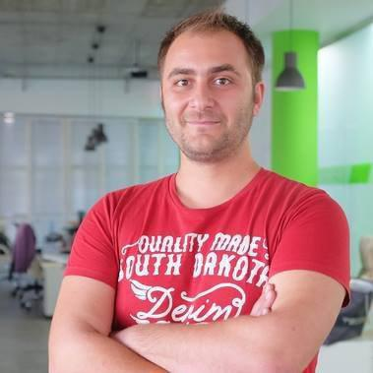
Doncho Minkov
Technical Lead & System Architect at SoftUni
10+ years in IT
8+ years of experience as a
Technical Trainer @ Telerik Academy
Front-end developer by heart
Software developer by need
Experience with all popular mobile platforms
Android, iOS, Windows
Fluent in Node.js, .NET, Angular, Java, C++
"30 under 30" – Forbes 2017 - Education

Slide 11

Course Organization

Slide 12
Python Web Basics Course
03-Nov-2020
13-Dec-2020
20-Dec-2020
Python Advanced
6 weeks * 2 times / week
15 credits
Start: 03-Nov-2020
Theoretical Exam: 13-Dec-2020
Project Defence: 13-Dec-2020
Re-Take Exams
Theoretical Retake Exam: 20-Dec-2020
Project Defence Retake: 20-Dec-2020

Slide 13


SoftUni Certificate
Project Defense 100%
Evaluation
13

Slide 14
CPE Certificate
Theoretical Exam 100%
Evaluation
14

Slide 15


Course Web Site, Forum and FB Group
Official web site:
Softuni Python Community group:
https://softuni.bg/trainings/3020/python-web-framework-november-2020
https://www.facebook.com/groups/SoftUniPythonCommunity

Slide 16
Questions?
Notes:
16

Slide 17
Trainings @ Software University (SoftUni)
Software University – High-Quality Education, Profession and Job for Software Developers
softuni.bg, softuni.org
Software University Foundation
softuni.foundation
Software University @ Facebook
facebook.com/SoftwareUniversity
Software University Forums
forum.softuni.bg
17
Notes:
17

Slide 18

License
This course (slides, examples, demos, exercises, homework, documents, videos and other assets) is copyrighted content
Unauthorized copy, reproduction or use is illegal
© SoftUni – https://about.softuni.bg
© Software University – https://softuni.bg
Notes:
18

